Slide 1
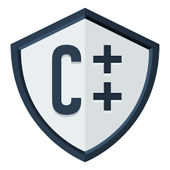
CSE202 OBJECT ORIENTED Programming

Slide 2
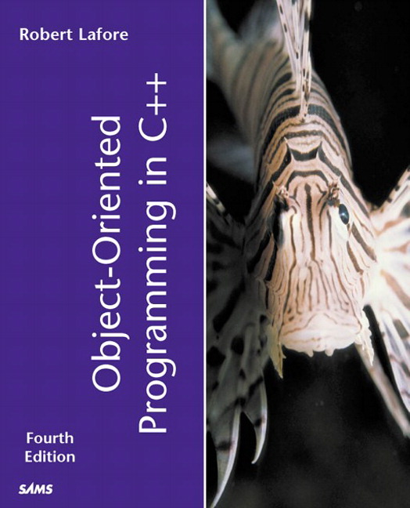
Course Details
[Five Hours/week]
Text Book
“OBJECT ORIENTED
PROGRAMMING IN C++”
by
Robert Lafore
L | T | P
3 | 0 | 2

Slide 3
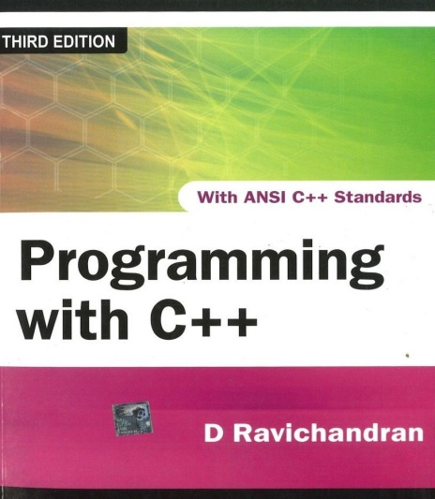
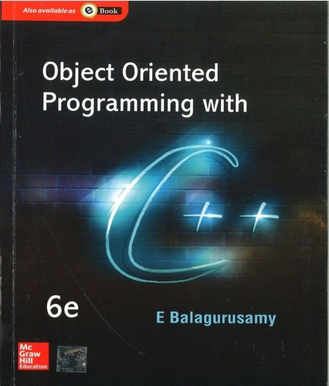
Reference Books
PROGRAMMING WITH C++
by
D RAVICHANDRAN
OBJECT ORIENTED
PROGRAMMING IN C++
by
E BALAGURUSAMY

Slide 4
Course Outcomes
CO1 :: identify basic programming constructs and use the newly acquired skills to solve extensive programming problems.
CO2 :: discuss the mechanism of code reusability by creating own libraries of functions.
CO3 :: validate the logic building and code formulation by designing code capable of passing various test cases.
CO4 :: interpret the principles of the object-oriented model and apply it in the implementation in C++ language.
CO5 :: develop accurate, reliable and efficient software applications.
CO6 :: apply the knowledge acquired to develop software applications

Slide 5
Course Assessment Model
CSE205 Marks break up*
Attendance 5
Daily Practice Problems 20
CA (Two best out of Three ATs) 30
ETP (Practical /Laptop) 45
Total 100

Slide 6
Academic Task
Component Week
Test 1 5th
Test 2 10th
Test 3 12th

Slide 7
CA
Programming Practice using IamNeo Platform
Best 2 out of 3 Academic Task
Programming practice is a compulsory requirement
50
ETP
Will be conducted on IamNeo Platform

Slide 8
Practice Problems
In the Practice Problems marks are only for coding Problems.
MCQs are only for practice.
Sequence locking:
Student must has completed all the problems of lecture 1, to complete the problems of lecture 2.

Slide 9
Academic Task
Each Academic task will contain 2 coding questions and 10 MCQs
The weightage of programming practice which is spread across 150 problems with 25 problems per unit will be 20%.

Slide 10
Marks Calculation for Programming Practice
In order to qualify for programming practice marks, the student must solve a minimum of 50% (75 Coding Problems) problems (eligibility condition)
No marks for MCQs.
Scoring Criteria:
If the student scores ≥ 81% in all CA's (best 2 out of 3), they will be eligible for 100% of the programming practice marks.
If the student scores between 71% - 80% (inclusive) in all CA's (best 2 out of 3), they will be eligible for 70% of the programming practice marks.

Slide 11
Marks Calculation for Programming Practice
III. If the student scores between 51% - 70% (inclusive) in all CA's (best 2 out of 3), they will be eligible for 50% of the programming practice marks.
IV. If the student scores between 30% - 50% (inclusive) in all CA's (best 2 out of 3), they will be eligible for 30% of the programming practice marks.
V. If the student scores less than 30% in the CA's (best 2 out of 3), they will not be eligible for any benefit.

Slide 12
Daily Practice Problems
S. No | Unit | Question | Tentative Dates for Completion
1 | Unit-1 | 25 Multiple Choice Questions and 25 Practical Implementation problems in each unit | 27th August 2023
2 | Unit-2 |  | 10th September 2023
3 | Unit-3 |  | 24th September 2023
4 | Unit-4 |  | 22nd October 2023
5 | Unit-5 |  | 5th November 2023
6 | Unit-6 |  | 12th November 2023
Note:- Most Important for the improvement of Performance in Course Assessments.

Slide 13
End Term Practical (45 Marks)
Coding Problems [70%]
Viva [30%]

Slide 14
Platform Used
Live Demostration of IamNeo Platform
URL: https://lpucolab438.examly.io/login
UserName: RegistrationNumber@neocolab.ai
Password: Registration Number

Slide 15
Why a Star Course?
This course Serves as the basis for the product based pathways
This course is a star course as it has direct bearing with the placements.

Slide 16

The hitch……
Some burning questions in mind......
Is C the only language behind the development of all these powerful softwares
Why C++?
How C++ is different from C language?
Is there no scope of this language in industry?

Slide 17
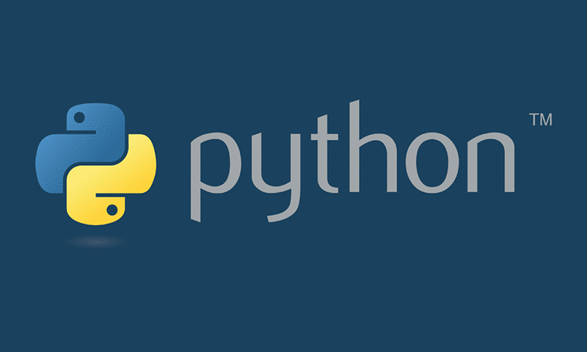
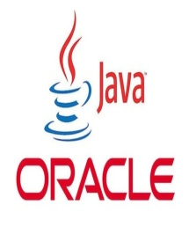
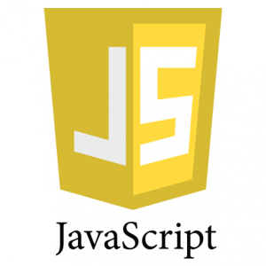
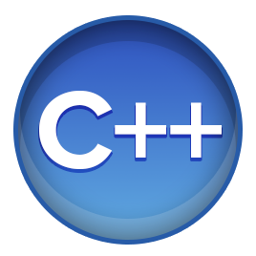
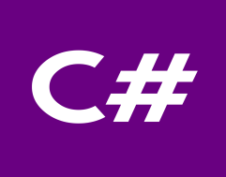

Flashback………..
What C language can do?????
Device drivers are written in C language.
All these modern programming languages are influenced by C language
Compilers for Python and PHP language are also written in C language
Embedded systems are also developed with the help of C language

Slide 18

Is C only language?????
Lets answers your questions
No, C is not the only language for the development of all these powerful system
If we talk about Windows operating system, only Kernel is written in C language rest all other features are provided with the help of C++ language

Slide 19
How does it differ from C
C uses top down approach for problem solving
There are no means of providing security.
C doesn't support inheritance, makes it more complex to use because everything has to be written from scratch.
C is not able to represent real world modelling

Slide 20







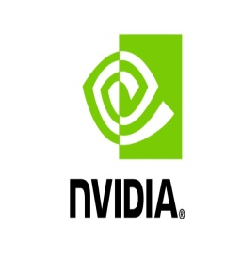




No scope of language in Industry
Top rated Companies which has a dearth of C++ programmers

Slide 21
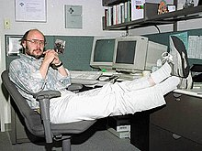
Introduction to C++
In 1979, Bjarne Stroustrup, began work on "C with Classes”
The motivation for creating a new language originated from Stroustrup's experience in programming for his Ph.D. thesis.
Stroustrup found that Simula had features
that were very helpful for large software
development, but the language was too
slow for practical use, while BCPL was fast but
too low-level to be suitable for large
software development.

Slide 22
Q1
Major objective for C++ is to:
A. Represent real world entities in the form of objects
B. Implement procedural approach
C. Implement top down approach
D. Implement functional programming

Slide 23
Q2
Initial name of C++ was:
C++ with classes
C with classes
Objects with C++
C with objects

Slide 24

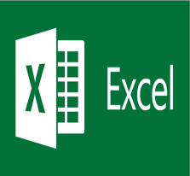





Applications
Git
 | Microsoft Excel
Oracle Database
 | MySql
Linux
 | Unix
Android
 | Google

Slide 25
WHY C++?????
Lets see

Slide 26
Key features of C++
Object and Classes
Real world modelling
Encapsulation
Wrapping
Data Abstraction
Hiding of non required information
Inheritance
Reusability

Slide 27
Key features of C++
Polymorphism
Many forms
Data Hiding
Security
Message Passing
Communication

Slide 28

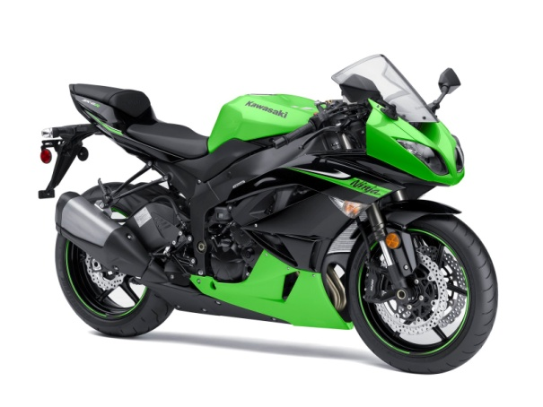
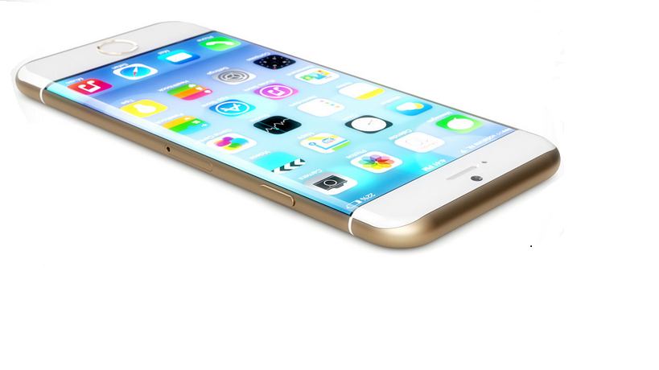

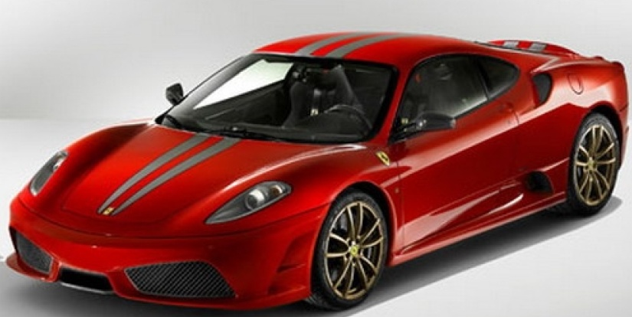

(Objects)Daily Analysis
Look around you and identify some objects
Everything is an OBJECT

Slide 29
Object ,Object and Object
A student, a professor
A desk, a chair, a classroom, a building
A university, a city, a country
A subject such as CS, Math, History, …

Slide 30
Procedural Approach(C Language)
Focus is on procedures
All data is shared: no protection
More difficult to modify
Hard to manage complexity

Slide 31
Data is not secure……..
FUNCTION 1
DATA 1
FUNCTION 2
DATA 2
FUNCTION 3

Slide 32
Object Oriented Approach
Emphasis is on data rather than procedure
Programs are divided into what are known as objects
Data is hidden and cannot be accessed by external functions
New data and functions can be easily added whenever necessary

Slide 33
MEMBER
FUNCTIONS
DATA
MEMBER
FUNCTIONS
DATA
MEMBER
FUNCTIONS
DATA
OBJECT ORIENTED APPROACHABSTRACTION & ENCAPSULATION

Slide 34
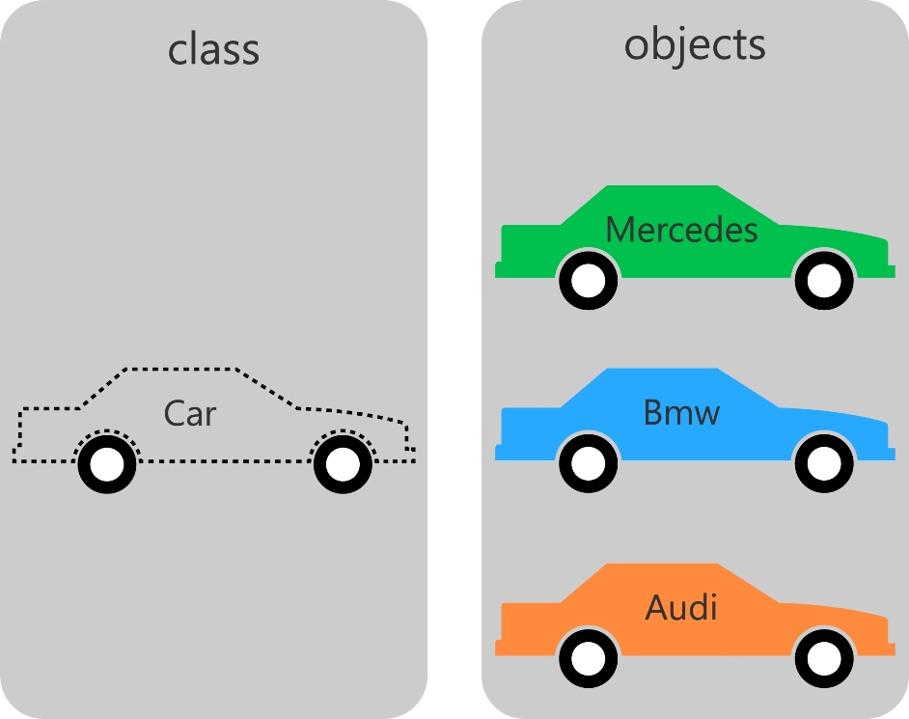
Classes and Objects(Example 1)

Slide 35
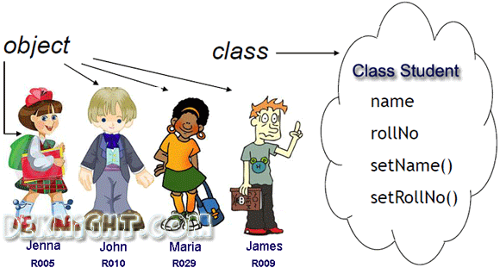
Classes and Objects(Example 2)

Slide 36
Classes and Objects
A class is a prototype or blueprint for creating objects
When we write a program in an object-oriented languages like C++,Java, we define classes, which in turn are used to create objects

Slide 37
Classes and Objects(Technical Example)
class
Time
inTime
hour
minute
void addMinutes( int m )
Attributes: hour = 8 minute = 30 Methods: void addMinutes(int m)
outTime
Attributes: hour = 17 minute = 35 Methods: void addMinutes(int m)
objects

Slide 38
History of Object-Oriented Programming
Started out for simulation of complex man-machine systems, but was soon realized that it was suitable for all complex programming projects
SIMULA I (1962-65) and Simula 67 (1967) were the first two object-oriented languages
Developed at the Norwegian Computing Center, Oslo, Norway by Ole-Johan Dahl and Kristen Nygaard
Simula 67 introduced most of the key concepts of object-oriented programming: objects and classes, subclasses (“inheritance”), virtual procedures

Slide 39
The Ideas Spread
Alan Kay, Adele Goldberg and colleagues at Xerox PARC extend the ideas of Simula in developing Smalltalk (1970’s)
Bjarne Stroustrup develops C++ (1980’s) at AT &T Bell Labs in Murray Hill, New Jersey, USA
Brings object oriented concepts into the C programming language
Earlier name was C with Classes
Later in 1983 the name changed to C++(The idea of ++ is taken from the increment operator of C)
In 1997, the ANSI/ISO made changes into the language and it was standardised

Slide 40
Features Continued…
Encapsulation
Abstraction
Reusability
Inheritance
Polymorphism

Slide 41
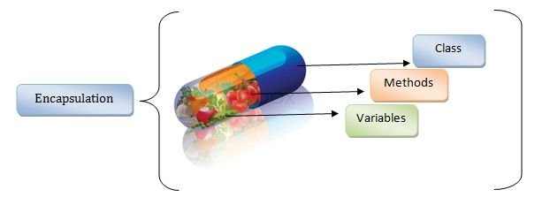
Encapsulation

Slide 42
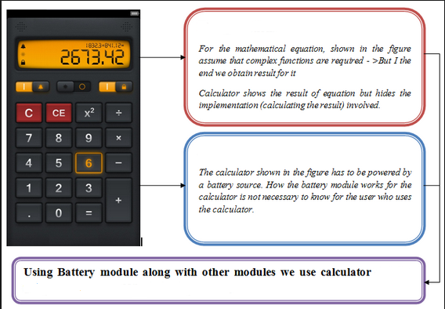
Abstraction(Hiding Details)

Slide 43
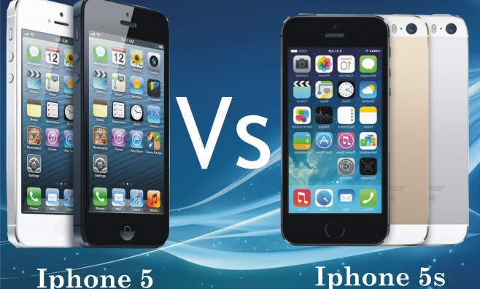
Reusability
Existing Features
Existing Features + Additional Features

Slide 44
Inheritance
But Mummy, where did my blue eyes come from?

Slide 45
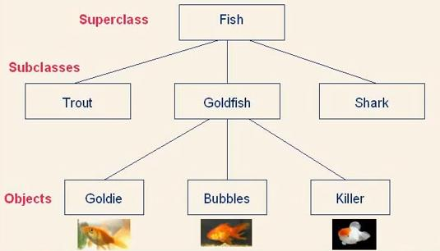
Inheritance….

Slide 46



Polymorphism
In front of father
In class
In CCD
One thing and many forms

Slide 47
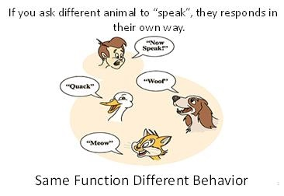
Polymorphism
Ability to appear in many forms…

Slide 48
Course Contents
Classes and Objects | Operator Overloading
Functions | Type Conversion
Pointer Array String | Inheritance DMA Polymorphism
Constructor and Destructor | Exception Handling
File Handling | Templates and STL

